Slide 1

DDOS Attack
Team members:
Mohamed Salah
Andrew Doss
Mohamed Hany
Mohamed Salem

Slide 2
Problem Formulation
Danger of DDOS Attacks
Challenge of Distinguishing Attacks
Tremendous Number of Features
Hackers' Methods to Make Attacks More Hidden
Difficulty for Detection by Humans and Simple Programs

Slide 3
Solutions and Contribution
Multiclassification of the DDOS Attacks Types.
Using popular dataset like "CIC-DDoS2019"
Data Cleansing and preprocessing Techniques
Use different modeling techniques
Evaluate the models and fine-tune using different techniques.

Slide 4
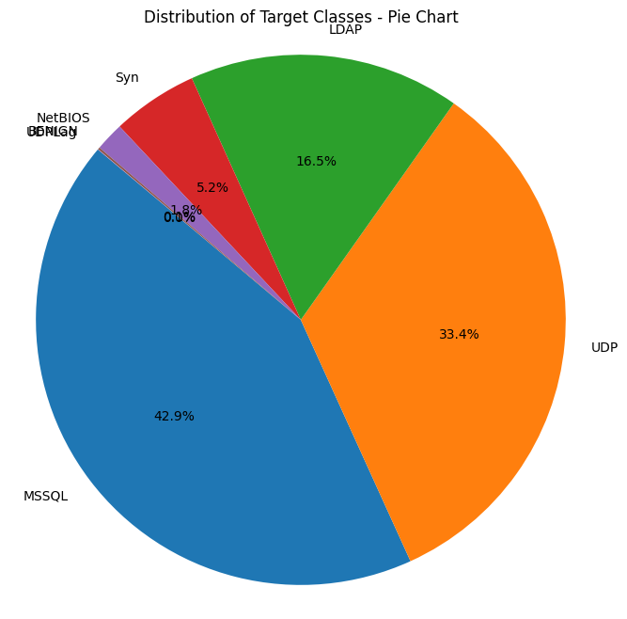
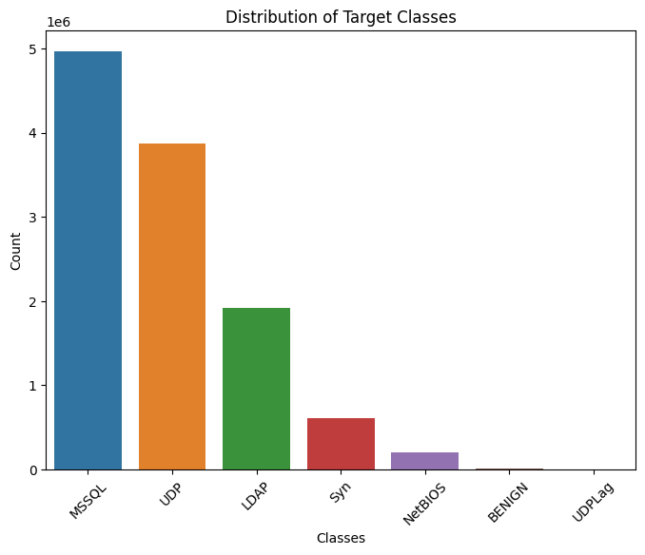
Data Gathering
Overview of dataset
Data Distribution
Our dataset comprises 4 CSV files. It encompasses data from 7 distinct categories.
The dataset is substantial, containing over 11 million rows and 87 columns.
dataset displays an unbalanced distribution across categories.

Slide 5
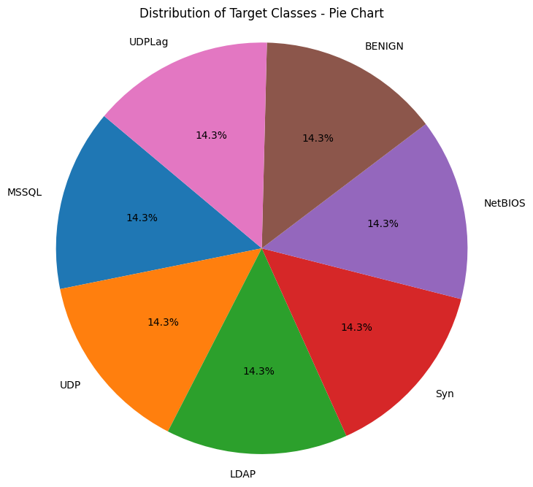
Data Preprocessing
1
Data Cleaning
Removing nulls
duplicate data
handling missing data
2
Data Balancing
distributed 1,000,000 records equally into 7 categories
14.3% for each class
oversampling and downsampling techniques to achieve a balanced dataset.
3
Data Saving & Loading
1,000,000 records is stored in a dataframe
exported as a CSV file
reload this file for further work

Slide 6
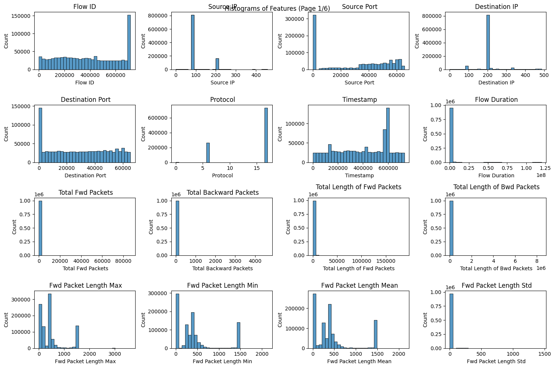
Exploratory Data Analysis
Feature Distributions

Slide 7
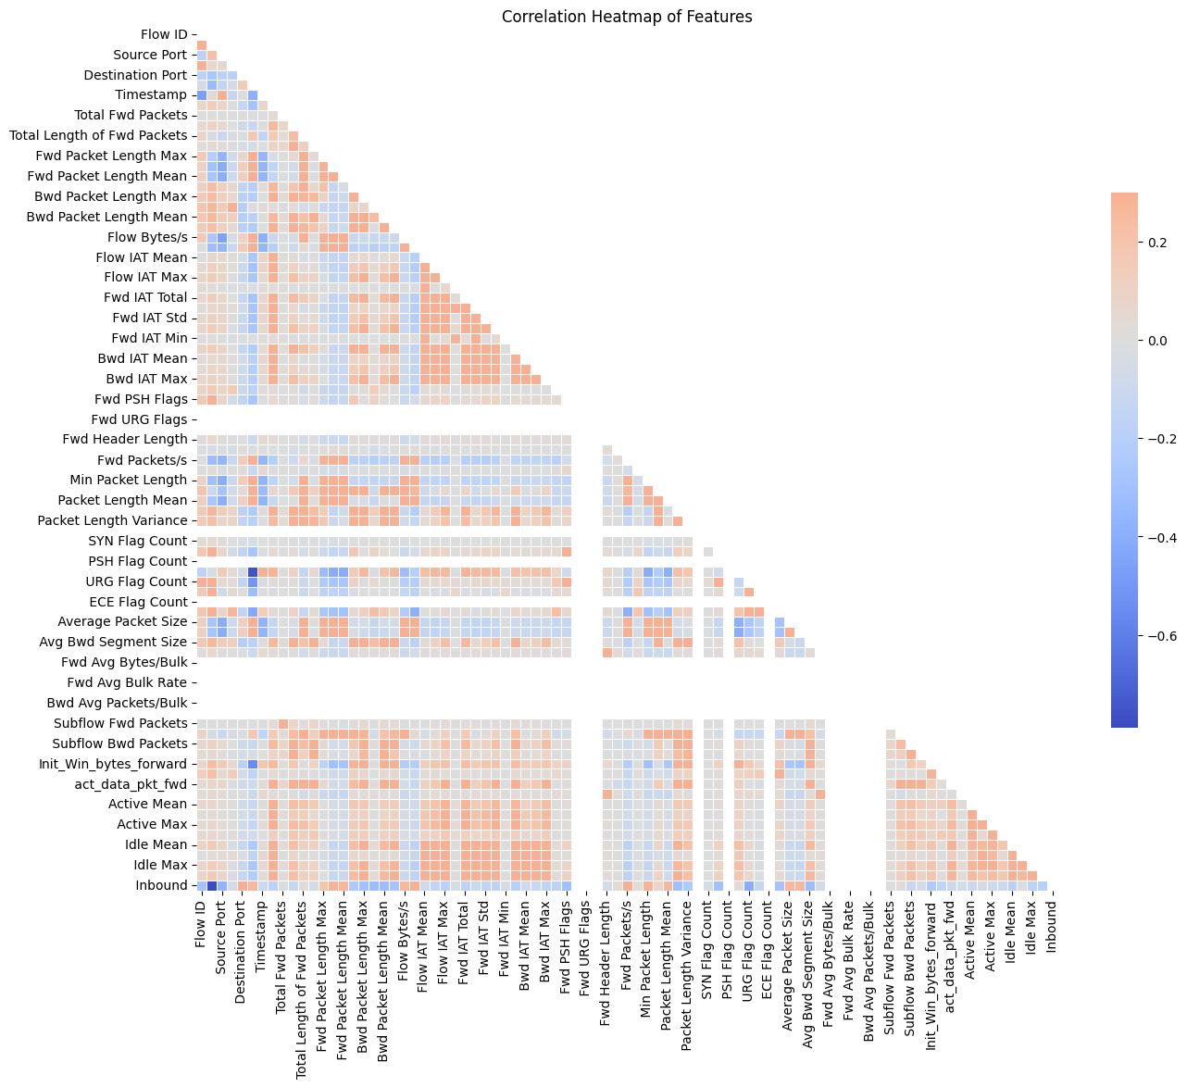
Exploratory Data Analysis
Correlation Heatmap

Slide 8
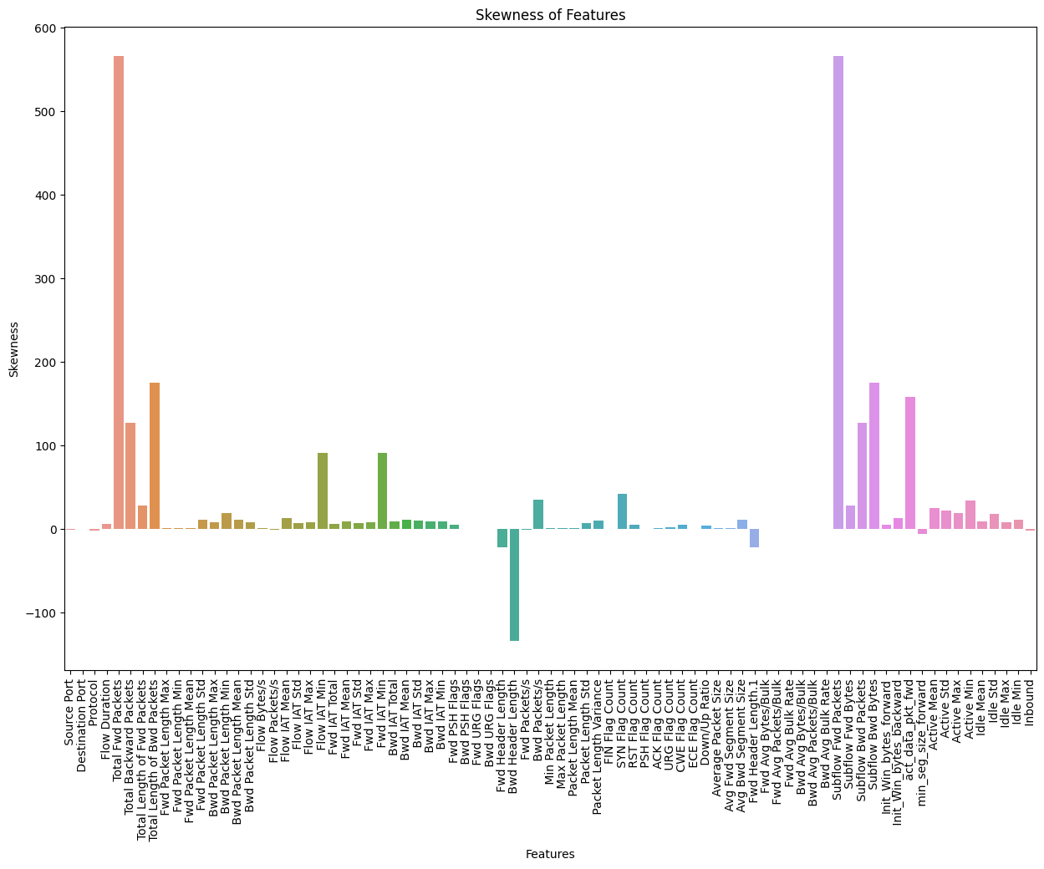
Exploratory Data Analysis
Skewness of Features

Slide 9
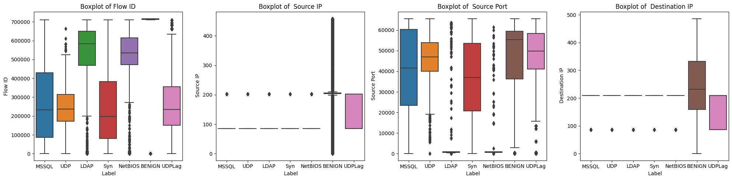
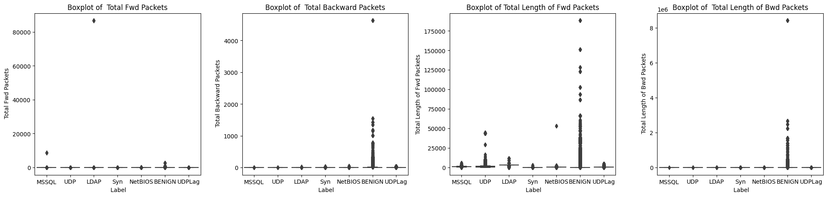
Exploratory Data Analysis
Boxplot

Slide 10
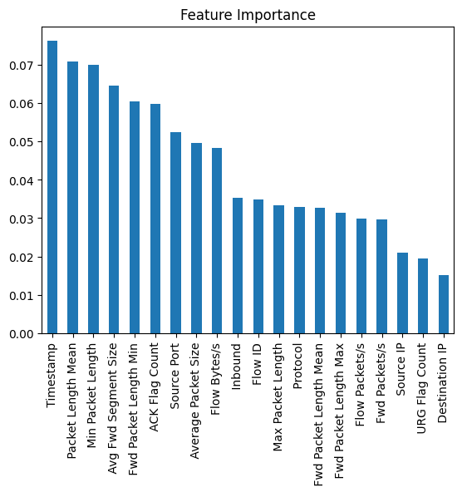
Feature Engineering & Selection
1
Selecting the Best Features
2
Data Standardization
3
Train-test split
4
Label encoding

Slide 11
Models Training and Selection
The baseline model
The traditional model
The boosting model
The Bagging model
Random Forest as benchmark
accuracy (94.5%)
F1-Score (92.25%)
SVM
Logistic Regression
Gradient Boosting
Ada Boosting
Random forest
Bagging Classifier

Slide 12
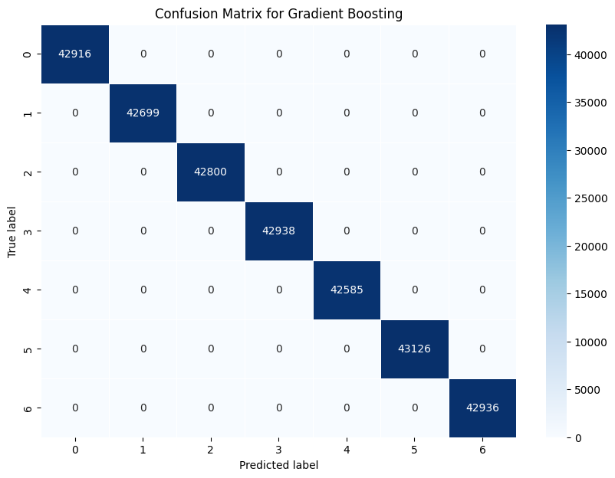
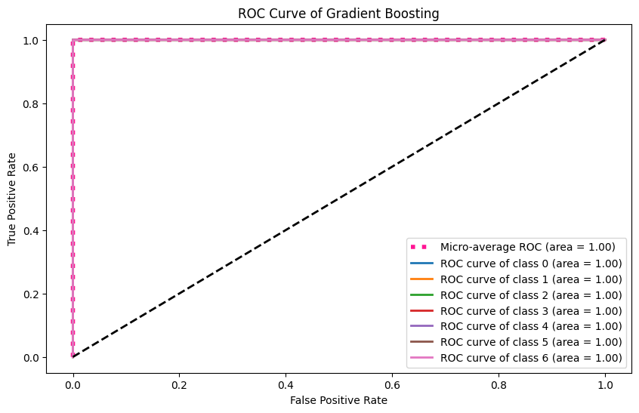
Model Evaluation
Performance Metrics
We have chosen to use:
F1-score as a metric in classification due to its ability to provide a balanced assessment of precision and recall.
Accuracy because it provides a clear and easily understandable measure of how well a model is performing.
Visualization of Performance
To visualize performance, we used the Confusion matrix and ROC curve.

Slide 13
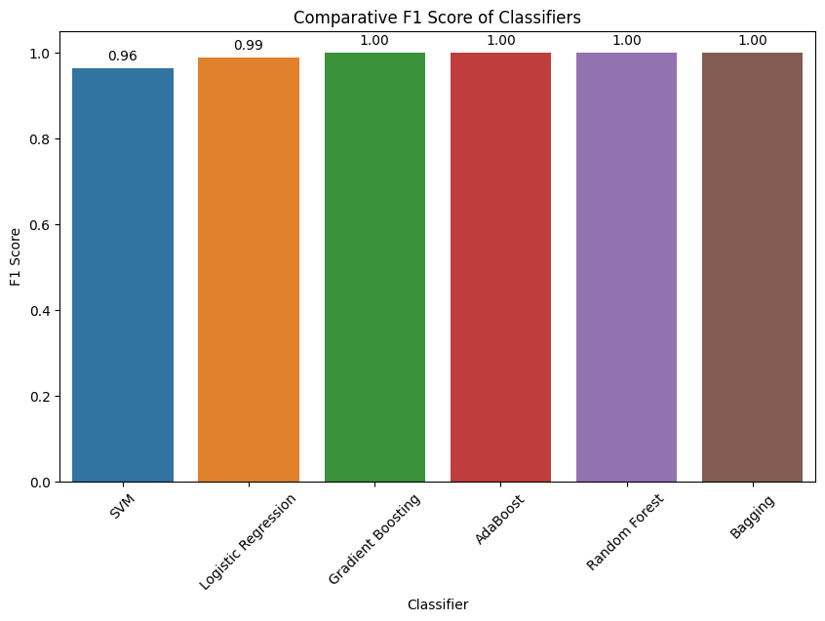

Model Evaluation
Comparative F1 Score of Classifiers
Comparative Accuracy of Classifiers

Slide 14
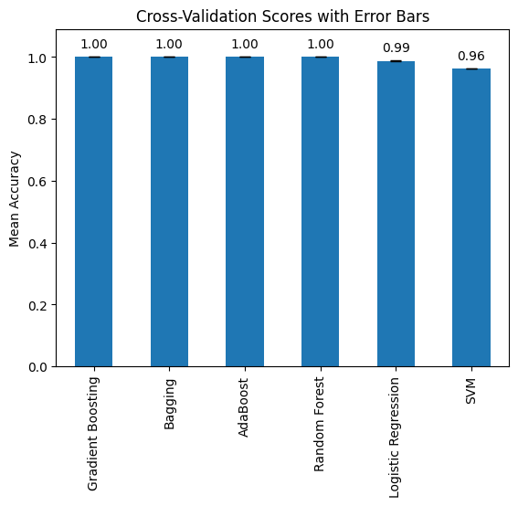
Fine-Tuning
Cross Validation
Model | Mean Accuracy
SVM | 0.962943
Logistic Regression | 0.987687
Gradient Boosting | 0.999994
AdaBoost | 0.999987
Random Forest | 0.999946

Slide 15
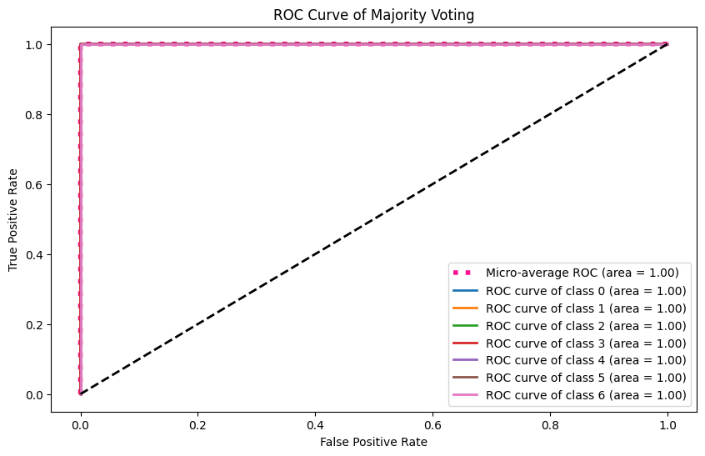

Fine-Tuning
Using majority voting technique for ensemble classification
Accuracy Score for Majority Voting | 100%
F1 Score for Majority Voting | 100%

Slide 16
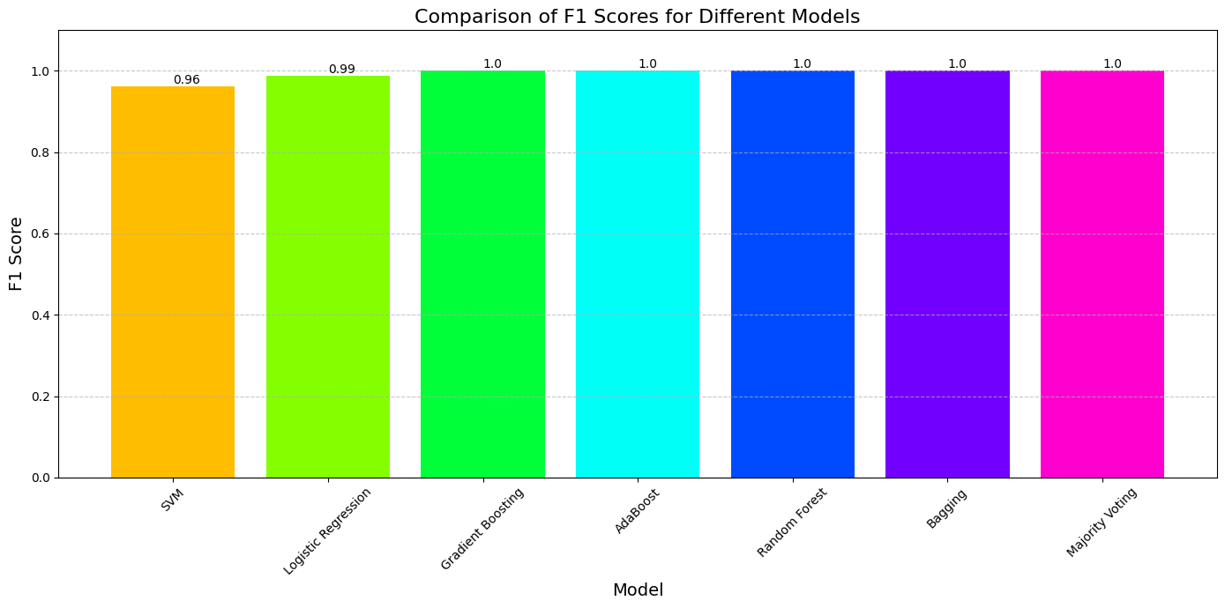
Overall Result

Slide 17
Conclusion
Successful Detection of Diverse Attack Types
Exceptional Performance Metrics
Efficient Data Preprocessing and Model Implementation
Deployment-Ready Solutions

Slide 18


